Slide 1
Aws pricing
ow

Slide 2
Pay as you Go
AWS offers, pay as you go, model, that is you only pay what you use.
Let’s take an example to understand this:
Suppose you are using say 10GB of space on AWS infrastructure, now usually what happens is, you estimate your usage say 40GB, reserve it, and pay for that 40GB monthly. But what if you are not using the whole 40GB. Like in our example, you just have 10GB of data, so if you are using AWS, you just pay for that 10GB, and you can always store more as your requirements grow, there is no restriction!

Slide 3
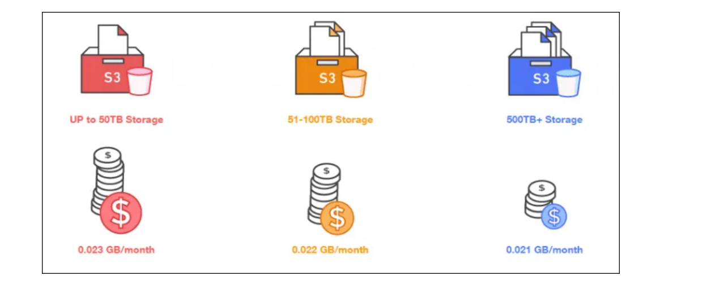
Payless by using more
WS bills you for the hour. The more AWS resources you use, the less the hourly rates become.

Slide 4
Save when you reserve
Though AWS has on-demand instances, but in services like AWS EC2 and RDS you have an option of reserving your instances as well, for a specific time frame.
Why would you reserve? You can reduce your costs up to 75 percent when you use reserved instances compared to On Demand instances.

Slide 5
Pricing model
No Upfront
In No upfront, you don’t pay anything before you reserve the instance, but since there is no advance payment, the costs are higher than the other two options.
Partial Upfront
In Partial Upfront, you pay a partial amount when you are reserving the instance, the costs in this model are lesser as compared to No upfront, but is still more expensive than full upfront.
Full Upfront
In Full Upfront, you pay the whole amount when you are reserving the instance, and the pricing is least in this case since you are paying the full payment.

Slide 6
calc
AWS Calculator
AWS Calculator is used to calculating your monthly expenses, it can be used to foresee, what will be your expenditure if you use a certain set of resources, it also provides you with templates to appraise complete solutions.
TCO Calculator
TCO(Total Cost of Ownership) Calculator is used to compare one service’s price to another, or one infrastructure solution to the other, it matches your current infrastructure to the most cost-efficient AWS offerings

Slide 7
AWS Free Tier
The Introductory free tier is given to all AWS customers on their SignUp, and it is valid for 12 months from the day they register on AWS.
Amazon EC2
It offers 750 hours of free Windows or Linux t2.micro instance usage per month.
So you can either run 1 instance for 750 hours for one month or two instances for half a month.
Amazon S3
It offers 5GB of standard storage on S3
20,000 Get requests
2,000 Put requests

Slide 8
..
Amazon RDS
750 hours of free db.t2.micro instance
20 GB of DB storage: any combination of SSD or Magnetic
20GB of backups with RDS Magnetic storage
10,000,000 Ios
AWS Lambda
1,000,000 free requests per month

Slide 9
..
Amazon CloudWatch
10 Amazon CloudWatch custom metrics, 1,000,000 API requests.
5GB of log data ingestion.
5GB of log data Archive.
3 Dashboards with up to 50 metrics each per month.

